Slide 1
DoD SkillBridge Program: Talent Acquisition Gold Mine
Notes:
Gold Mine” is appropriate. SkillBridge benefits the Servicemember, Businesses, CareerSource and the community. SkB is a LVERs friend – an incredible opportunity most of us did not have. I hope to convince you to add this tool to your toolbox.
Survey – Have you heard of it? Raise hands for general understanding. Any participants? I like informal- I’ll certainly take any questions at the conclusion, Ask your questions anytime. We’ll all get the most out of this thru discission.

Slide 2
Agenda
https://skillbridge.osd.mil
SkillBridge Overview
Service Member Process
Employer Process
CareerSource Process
Program Highlights
Notes:
I’ll start with a basic overview of what SkB is, why it’s a goldmine, and why you want to participate. We’ll discuss key player roles and responsibilities, program highlights, and wrap up with a 5W summary and your questions.

Slide 3
Overview
https://skillbridge.osd.mil
SkillBridge is an opportunity for servicemembers to gain valuable civilian work experience through specific industry training, apprenticeships, or internships during the last 180 days of military service prior to separation. Service members participate while on Active Duty.
No downside. TSM provided glidepath to soft post-exit landing; businesses incur no cost, liability or risk, gain access premier talent pipeline, and have minimal admin requirements.
GAO reports ~ 200k servicemembers separate from the military each year. SkillBridge connects Florida to them.
Notes:
180 days out- service members gain training and experience that’s gold for their transition.
Everyone wins. TSM get theirs; no brainer for business; CareerSource is front and center.
It’s huge! 200k TSM’s, and the pipeline is steady.

Slide 4
Overview
https://skillbridge.osd.mil
DoD program = world-wide. SkillBridge applicants come from across the globe wanting return “home” to Florida. CSOW placed heroes from Kadena AFB (Japan), Joint Base Lewis-McCord (Washington State), Moody AFB, and more. Thirty percent outside local area.
DoD points applicants to the official website to review the map of approved programs. CareerSource bridges the gap with local business opportunities.
Makes CareerSource a talent broker for THE premier talent pipeline.
Notes:
Not just a local deal ~30% of applicants come from “other” locations. They were stationed here before, grew up here or want to be here-Veteran friendly, taxes, climate, etc.

Slide 5
Overview - Tracks
Internship
Registered Apprenticeship
Employment Skills Training
Notes:
Three tracks – we have focused solely on internships- it was just a good space for us. We spent our time taking individual TSM applications and working with local businesses to create a match.
Be registered with U.S. Department of Labor (DOL) and/or registered in the state in which it operates - See U.S. DOL’s “List of State Apprenticeship Websites” - https://www.apprenticeship.gov/
b. Be an “Education and Job Training Program” approved by the U.S. Department of Veterans Affairs (VA). See U.S. Department of Veterans Affairs “Search for Approved Education and Job Training Programs” web site - http://inquiry.vba.va.gov/weamspub/buildSearchInstitutionCriteria.do.
c. Be a certificate program accredited by the American National Standards Institute (ANSI). See ANSI’s “Directory of Accredited Certificate Issuers, Applicants, and Suspended Issuers” web site https://www.ansica.org/wwwversion2/outside/CAPdirectory.asp?menuID=212
d. Be accredited by an accrediting agency recognized by the U.S. Department of Education. See U.S. Department of Education’s “Database of Accredited Programs and Institutions” web site – http://www2.ed.gov/admins/finaid/accred/index.htm

Slide 6
Servicemember Process
Program is open to all ranks of military personnel
Military member applies to participate in the program by contacting their installation Education’s point of contact (USAF)
Military member is referred to CareerSource
CareerSource assists with matching to internships and completing needed paperwork
Command approval must be granted prior to participation
CareerSource case manages participant during internship and assist with job search/job placement near the end of the internship
Notes:
You’ll certainly customize IAW your regional policies. Bottom line – a SkillBridge participant is much like any other candidate-consistent contact thru placement.

Slide 7
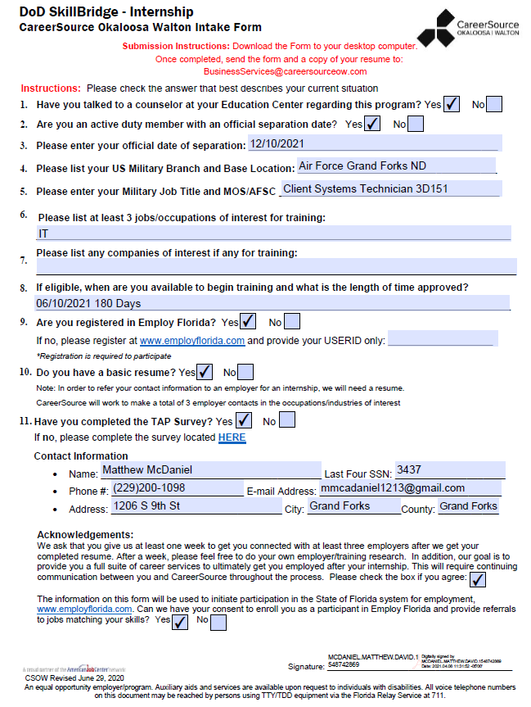
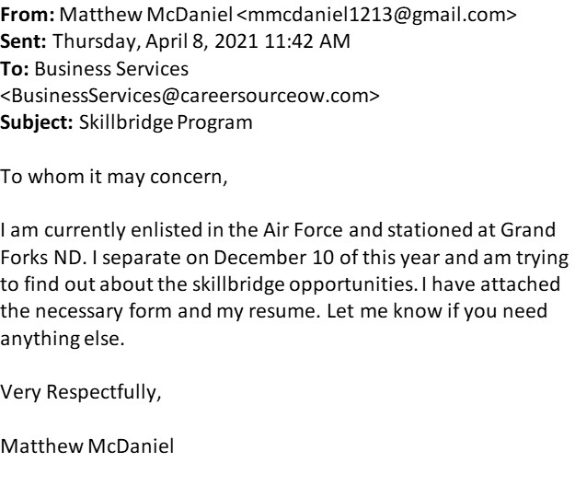
Application

Slide 8
Employer Process
CareerSource coordinate's introduction between TSM and employer
Employer develops internship(s) description and learning plan and provides to Veterans Florida and/ or CareerSource
Employer interviews potential interns and completes required paperwork
Internship begins after final approval from intern’s commander
Communicates with CareerSource on status of hiring intern
*CareerSource staff assists employers through the process
Notes:
All New. July 1st Veterans Florida became the principal agent for SkillBridge. October 1st, All participants must choose from an approved program from the site.
Just need to keep CareerSource’s seat at the table – work with both particpants and businesses to create opportunity.
We set it-up, Jeremey puts a bow on it.

Slide 9
CareerSource Process
Service member reaches out to CareerSource (EF registration, background wizard, and intake form)
First appointment (WP enrollment, explanation of process)
Follow up appointments (develop resume and a list of desired employers/internship locations)
Mid term internship appointment (status check in and deploy job search plan/job searches strategies).
Record placement/obtained employment
Track progress
Notes:
You’ll certainly implement IAW with your local policy. SkB applicants are a talent pipeline. Manage them as such.
Consistent contact from initial appointment, to placement, and follow-up.

Slide 10
Regional Process
CSOW – Community Co-Chair in formal agreement to support Air Force Community Partnership (AFCP) mandates.
Florida Defense Support Institute data validates requirement to retain TSMs.
Defense Manpower Data Center (DMDC) data and our TAP survey id’s critical talent pipeline.
Present at installations, AFRCs and Education Centers refer applicants to us.
Prior to Hurricane Michael, presented job services and other opportunities at Tyndall Air Force Base.
July 2020, established formal DoD SkillBridge agreement with Tyndall AFB.
TAP currently held bimonthly at Job Center facility during Tyndall’s rebuild project.
Job Center staff briefs TSMs on services and training opportunities.
Notes:
This is how CSOW and CSGC got there. Each region’s path will be different.
Partnership with and referrals from your installations is key.

Slide 11
Highlights
Workers' compensation is covered by military
Each military branch has a separate process for service members and vetting employers
Great tool for retaining talent in local community
Program provides another tool to assist employers and economic developers with recruitment
Notes:
It’s not too good to be true. Local HR will fight you on that. Educate yourself and sell it.
EDC’s love it- envision you region “on the map”.

Slide 12
Stack it Up – LVER Toolbox
180 days out = Dislocated worker. WIOA scholarships
Onward to Opportunity. PMP, HR, and IT Certifications
Hilton Honors
IWT / EWT / OJT
Veterans Florida matching Funds – 50/50 to $8k
Notes:
SkB fits nicely with everything we do. Stack-up the incentives to make your candidates irresistible.
Example- Mag Aero paying for Security plus to meet contractual requirements- let O2O, pay for that, VF and us for everything else they need.

Slide 13
OWF
Are you an active duty wounded, ill or injured Service member looking for an internship opportunity?
Operation Warfighter (OWF) is a Department of Defense internship program that matches qualified wounded, ill and injured Service members with non-funded federal internships for them to gain valuable work experience during their recovery and rehabilitation. This process assists with the Service members’ reintegration to duty, or transition into the civilian work environment where they can employ their newly acquired skills in a non-military work setting.

Slide 14
5Ws⁺
Who
What
When
Where
Why

